Slide 1
Shell Bootcamp 2024 Reflections for the Week
26/08/2024 to 30/08/2024
Sakshi Neeraj
Date : 30-Aug-2024

Slide 2

About Me
B. Tech Computer Science Engineer
Specialized in Data Analytics and Data Science
Permanent resident at Delhi
Organized
Good at time management
Hobby is cooking
Organized
Organized and managed

Slide 3

My learnings from this week!

Slide 4
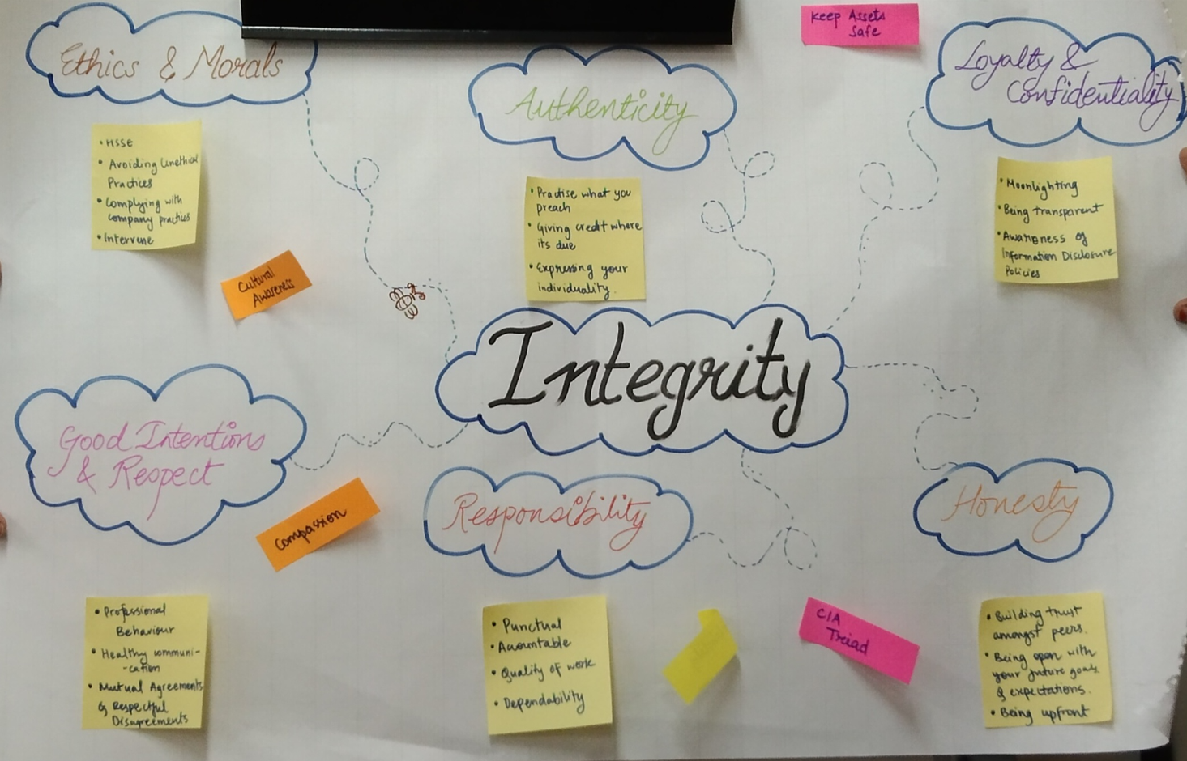
Learning 1 | My takeaways (26/08/2024)
Soft Skills
Attributes of a professional: Integrity, commitment, discipline, self awareness
Meeting etiquettes: Punctuality, prepare the agenda for the meeting, avoid interrupting people, keep phones on silent
E-Mail writing: TAT for replying to a mail is 24 hours, mail should not exceed 5MB, always put attachments at the starting of the mailer
POWER technique: Plan, organize, write, edit and review
Neuroplasticity: capacity of neurons and neural networks in the brain to change their connections and behavior in response to new information
Integrity for Professionals

Slide 5
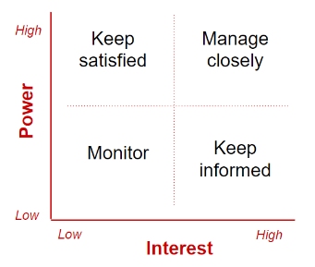
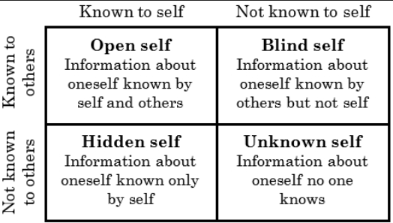
Learning 2 | My takeaways (27/08/2024)
Stakeholder management: Identify, plan, engage stakeholders to gather their requirements, work on stakeholder demands
Power-Interest grid: Stakeholders are divided based on the degree of power they exercise in a particular product and the extent of interest they have in the product
Neuro-linguistic programming: Knowing a person’s brain functioning i.e., whether the person is visionary, auditory or kinesis swayed
Shell’s trust model:
Trust = Credibility + Reliability + Intimacy
Power-Interest grid
Johari Window

Slide 6
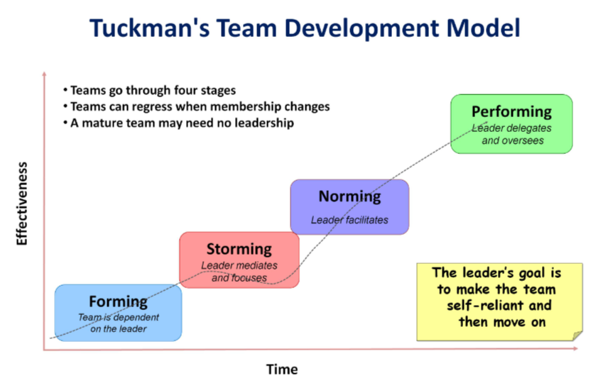
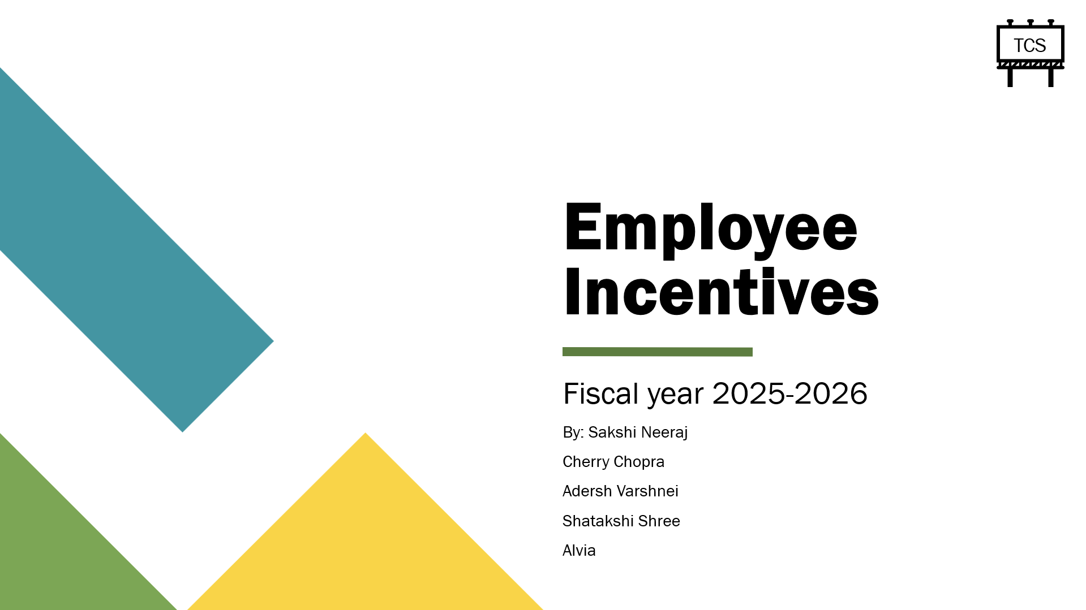
Learning 3 | My takeaways (28/08/2024)
Benefits of team-work: Quick solution, improved productivity, diverse ideas, distributed workload, learning opportunities from others
Qualities of a professional team: Synchronized, unified, have common goals, focused and dedicated
Feedbacks: A negative feedback should be sandwiched between 2 positive attributes to boost motivation and provide constructive criticism
Presentation skills: Know the audience, design outline of the PPT, spend time on proof reading
5 principals of presentation: Profile, pitch, pace, pause and practice
Presentation on Employee incentives (Group activity)

Slide 7
Learning 4 | My takeaways (29/08/2024)
BA and Agile
SDLC (Software Development Lifecycle)
Planning
Define requirements
Design prototype
Implement software
Testing
Deployment
Monitor and maintain
Waterfall model is useful for the software which have constant requirements
Business analysts gather and analyze the requirements for a software and communicate them to the developers
Functional Requirements | Non-Functional Requirements
Mandatory | Non-mandatory
Related to functionalities | Related to performance
Example: There should be a functionality to allow users to edit their profile | Example: Scalable application
Business analysts perform requirement elicitation, modelling and traceability

Slide 8
Management Techniques in a project
Work breakdown structures
Gantt charts
PERT chart
Kanban
Scrum
Agile
Agile has different roles like product owner, scrum master, scrum team members and stakeholders
4 principles of Agile
Working software is more important than documents
Customer collaboration is more important than contract
Changes according to the customer are important
Interaction is more important than processes and tools
Kanban has tasks segregated into various labels which show their statuses like backlog, in-progress, under-testing and done.

Slide 9
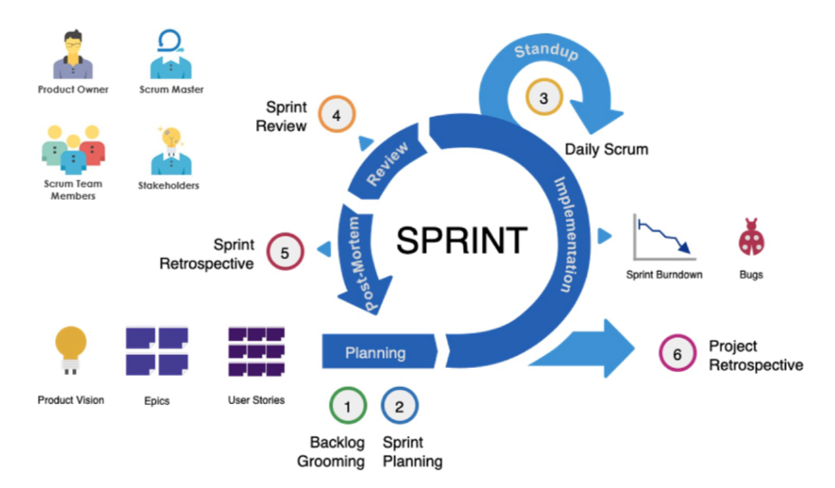
Learning 5 | My takeaways (30/08/2024)
Scrum is a technique of project management in which the whole team works collectively to achieve the project deliverables. Project is divided into different phases called sprints.
A sprint lasts for 2 to 4 weeks depending on the project. There is project planning on the day1 of the sprint, there is a daily scrum meeting of 15 minutes. At the end of each sprint, there is a review and retrospect meeting. Scrum board is used to give a visualization about how the team has performed and what tasks need to be completed
Benefits of Scrum:
Adaptability, continuous improvement, changes made in the requirements of the customer can be incorporated thus is customer centric
Disadvantages of Scrum:
No definite date and task might lead to disorganized approach to the project
Scrum life cycle

Slide 10

Relevance of learnings for my organization

Slide 11
Learning 1 | Relevance for Shell
Attributes of a professional: Learning about qualities of a professional helps us as individuals working for Shell as an organization flourishes when the employees uphold good attributes of a professional while being committed to their work and responsibilities.
Meeting etiquettes: Knowing basic meeting etiquettes is very essential in order to present ourselves during any formal conversation. Having meeting etiquettes would help us as employees to accomplish our goals in a collaborative environment leading to Shell’s success.
E-Mail writing: Learning to write formal mails is essential as it helps to establish a pathway to formal documented communications which are necessary for a collaborative and engaging work environment so that employees communicate with internal as well as external stakeholders smoothly resulting in project accomplishment.

Slide 12
Learning 2 and 3 | Relevance for Shell
Stakeholder management will help employees identify the important stakeholders for a project, engage with them and make them efficient to meet the demands of the stakeholders
Characterizing stakeholders based on their power and interest levels will help Shell recognize which are the group of stakeholders which need to be given utmost importance leading to smother functioning and delivery of products

Slide 13
Learning 4 and 5 | Relevance for Shell
Business Analysis will play a key role in any of the projects undertaken by Shell
Thus, knowledge about the process of gathering and analyzing the requirements of a product is integral
Learning about project management techniques like PERT and Work Breakdown Structure is necessary to work on any project efficiently so that the project can be broken down into phases and each phase can be completed smoothly
Scrum is a project management technique used for a structured and collaborative approach to product delivery
Agile and Scrum are customer centric and thus are essential for an organization’s smoother functioning
Scrum incorporates the provisions to make changes into the product in accordance with the customer needs

Slide 14

Challenges in implementing learning

Slide 15
Challenge faced while implementing Learning 1, 2 and 3
Characterizing stakeholders in accordance to their degree of power and interest in the product needed practice
Understanding their degree of authority and approximation of stakeholders’ interest in the product was a complex task
Building skills of a team player needed mutual understanding amongst the team members which took time
Effective communication amongst the team members in group tasks required efforts

Slide 16
Challenge faced while implementing Learning 4 and 5
Implementing Scrum lifecycle in real world use cases needed a deeper understanding of the Scrum elements
Formulation of epics and use cases of a real-world project took time and a comprehensive understanding of Sprint processes
Changing requirements in an Agile framework can be complex to handle

Slide 17

Action Plan

Slide 18
My Action Plan for this Week
Actions
Timeline
Status
Learn how to use Azure Devops
Learn how to create epics, features and user stories for devops pipelines
Learn Azure devops in next 1 week
To be able to make basic end to end devops projects

Slide 19

Learning is also Fun!

Slide 20
Learning is also Fun!
We did an activity of poster making related to qualities of a professional, the central quality was “integrity” around which other attributes like responsibility, honesty revolved.
We also made a presentation on “Employee incentive revision plan” which gave us a clear understanding as to how a comprehensive presentation should be delivered.
We designed Scrum epics and use cases for a project which gave us a practical note of how agile and scrum work for team collaboration.
Poster making
Presentation

Slide 21

Summary
Learnt about Soft Skills and their importance in a professional setting
Learnt about Business analysis and the importance of requirement gathering and understanding before execution
Started learning Azure Devops
Importance of topics of upcoming week:
Devops is essential for delivering products to the customer seamlessly and efficiently using CI/CD pipelines. It is also acts as a way for teams to collaborate on a shared platform
Learning about Database Management tools is essential so that data can be managed and the ETL (Extract, Transform, Load) can be performed efficiently
Software testing ensures that a product works according to its expectations and all the outputs are in coherence with the expectations of the product
Connectivity of topics from current week:
Learning Devops as the next topic can be useful as Scrum which is a technique of project management can be implemented using Azure Devops portal

Slide 22
Thank You

